Slide 1
  Lesson3: Book Of Business and Reporting

Slide 2
Lesson 3: Manager - BOB and Related Data
Customer
Customer
Policy
Search
Ownership Search
Customer
Search
Book Of Business
  Customer Search
  Customer Policy Search
  Ownership Search
Notes:
BOB and its interrelated details.

Slide 3
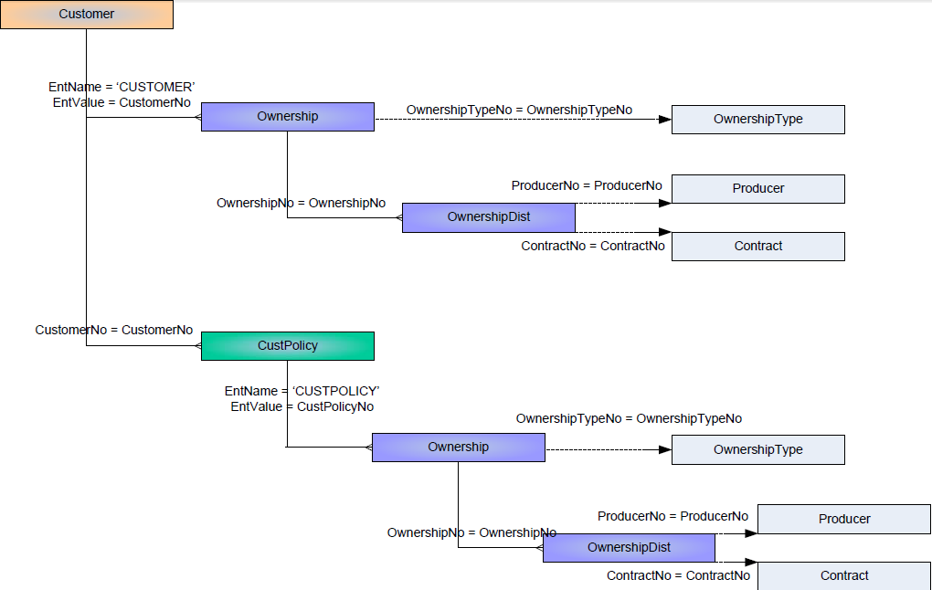
Lesson 3: BOB – Physical Data Model
Notes:
Let’s have a look on the Physical Data Model of BOB and its related data.

Slide 4
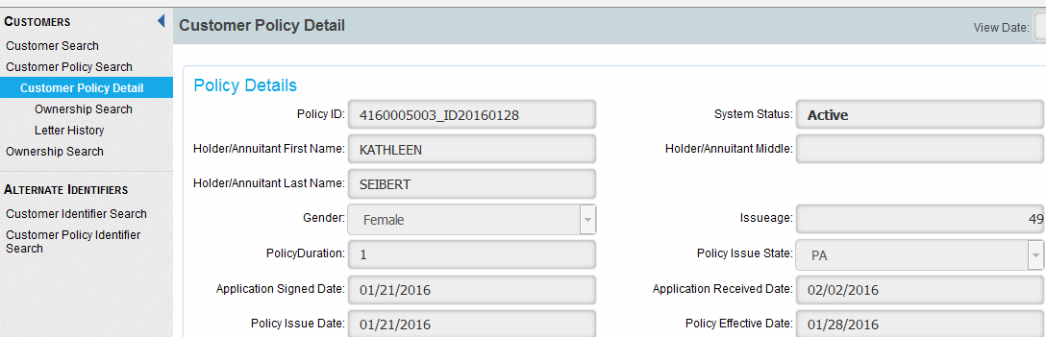
Lesson 3: BOB and Related Data
Notes:
How BOB and its interrelated data looks in ProducerPro screen.

Slide 5
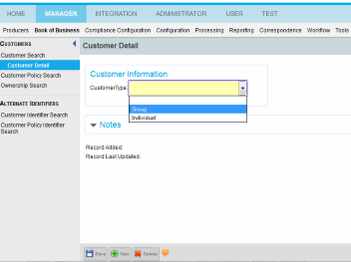
Lesson 3: BOB Traversing
Lets learn how to create a new Customer.
  Customer can be of the following types, such as Group, Individual
  Need to choose the Type from the list before creating a new one.
New Customer
Notes:
Customer can be of the following types. Such as Group, Individual.

Slide 6
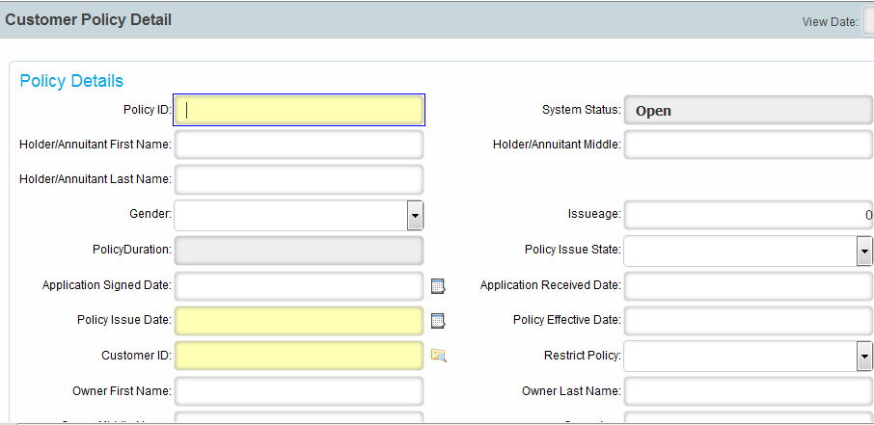
Lesson 3: BOB Traversing – Contd..
Lets learn how to create a new Customer Policy.
  After choosing the Customer Type and clicking on “NEW” button the screen appears.
Notes:
Click on the “NEW” button

Slide 7
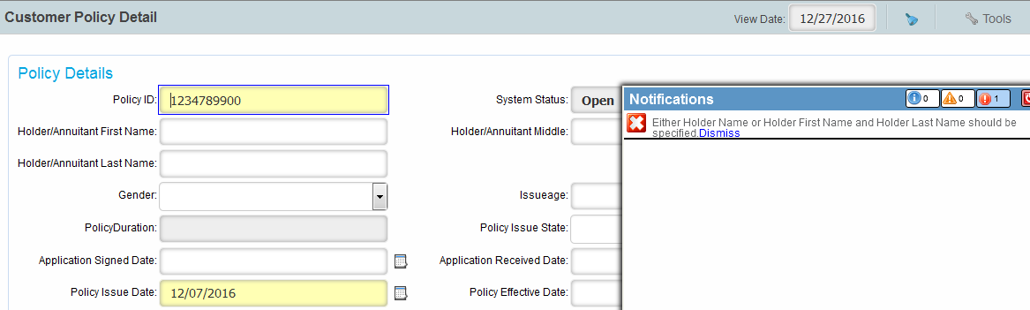
Lesson 3: BOB Traversing – Contd..
Lets learn how to create a new Customer.
  The fields marked in “Yellow” are mandatory fields.
  Few more fields are mandatory based on the “Customer Type” selected, once you try to click on “SAVE” button a top-up appears with the error message.
Notes:
Mandatory fields are marked in “Yellow”. “Policy Id” field is the unique field.
Few more fields are mandatory based on the “Customer Type” selected, once you try to click on “SAVE” button a top-up appears with the error message.

Slide 8
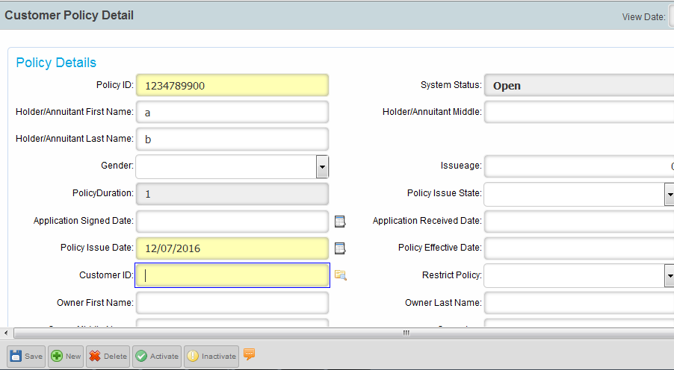
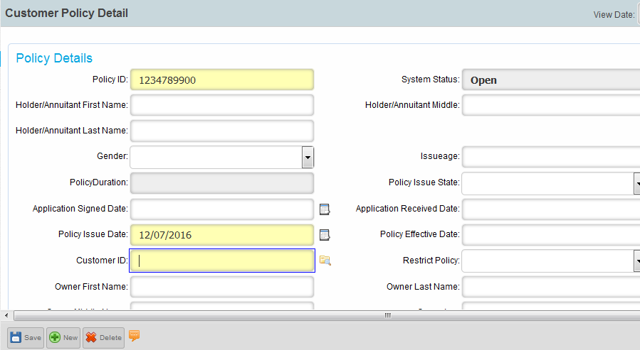
Lesson 3: BOB Traversing – Contd..
Lets learn how to create a new Customer Policy.
  Now as per the instruction add the value as per requirement, click on Save.
  Now click on Activate button, until and unless you click on Active button, record will remain Inactivate and no operations can be done.
Save
Activate
Notes:
After data addition, click on Save and Active button, else record will not be available for any actions.

Slide 9
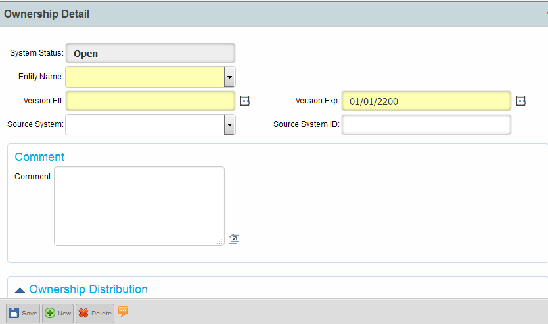
Lesson 3: BOB Traversing – Contd..
Lets learn how to create a new Ownership.
  The fields marked in “Yellow” are mandatory fields.
  Few more fields are mandatory based on the “Entity Name” selected, once you try to click on “SAVE” button a top-up appears with the error message.
Save
Notes:
The fields marked in “Yellow” are mandatory fields.
Few more fields are mandatory based on the “Entity Name” selected, once you try to click on “SAVE” button a top-up appears with the error message.

Slide 10
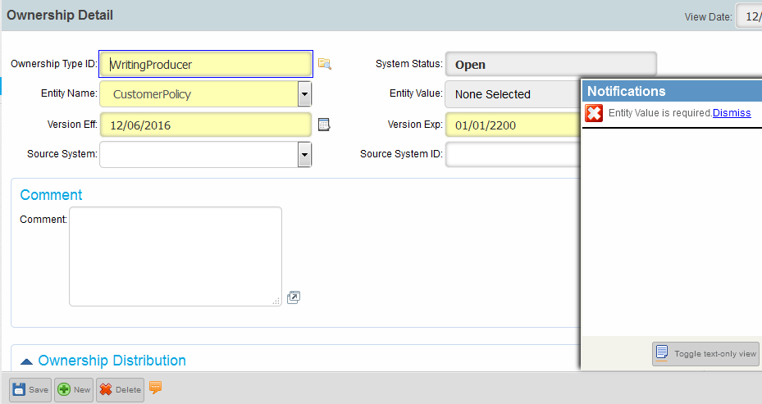
Lesson 3: BOB Traversing – Contd..
Lets learn how to create a new Ownership.
  The fields marked in “Yellow” are mandatory fields.
  Few more fields are mandatory based on the “Entity Name” selected, once you try to click on “SAVE” button a top-up appears with the error message.
Save

Slide 11
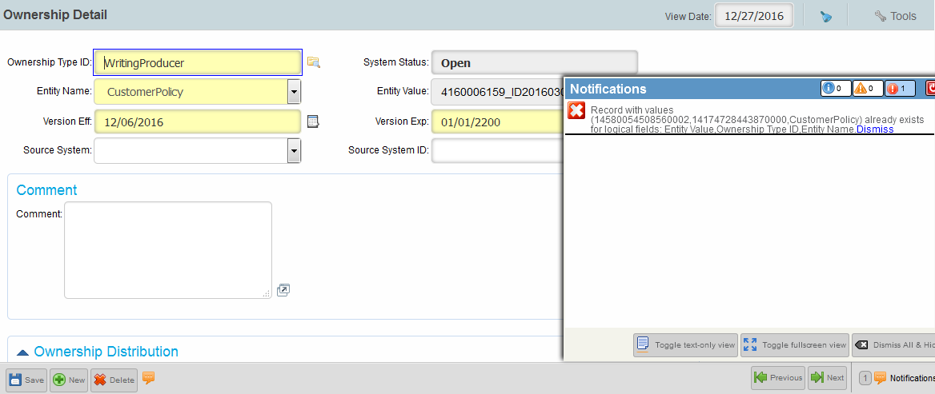
Lesson 3: BOB Traversing – Contd..
Lets learn how to create a new Ownership.
  The Ownership Detail should be unique, else it will generated the error shown.
Save
Notes:
The Ownership Detail should be unique.

Slide 12
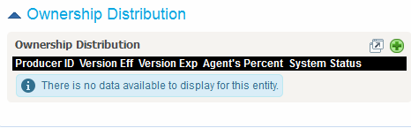
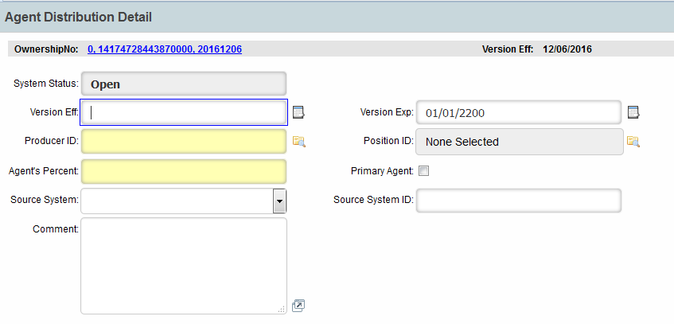
Lesson 3: BOB Traversing – Contd..
Ownership Distribution - Lets learn how to create/search.
This screen will appear after you save the new Ownership created.
Add
Notes:
This screen will appear after you save the new Ownership created.

Slide 13
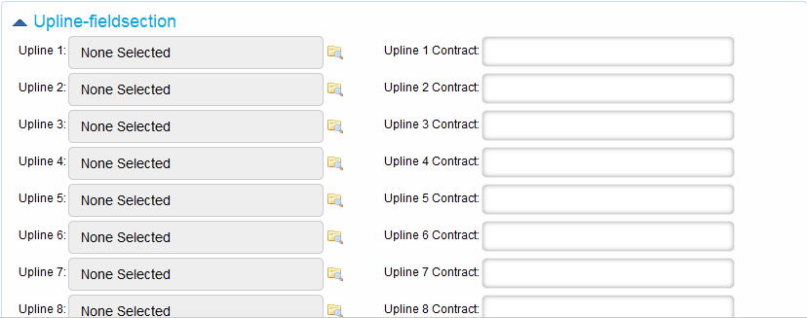
Lesson 2: BOB Traversing – Contd..
Ownership Distribution – Upline-fieldsection.
Choose the upline related to BOB for relationship and commission to be generated. Here we mainly select the agent id which belongs to Compensation hierarchy.
Notes:
Choose the upline related to BOB for relationship and commission to be generated. Here we mainly select the agented which belongs to Compensation hierarchy.

Slide 14
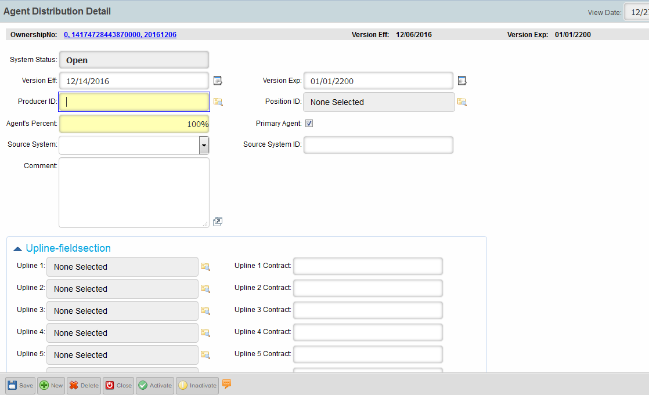
Lesson 2: BOB Traversing – Contd..
Ownership Distribution
Now click on Activate button.
Activate
Notes:
Example which can be implemented for unique agent identification (eg. Primary Agent) and one can also store the commission percent (eg. Agent percent)

Slide 15
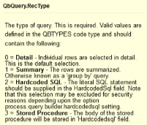
Lesson 2: Reporting QbQuery
QbQuery in Details … need to call SQL and PL/SQL codes.
  The fields marked in “Yellow” are mandatory fields.
  Select the “QueryContexts” as shown.
  Select the RecType as per need viz. Detail, Summary, HardCoded SQL, Stored Procedure.
Notes:
QbQuery is used to call PL/SQL block to perform business logic on any attribute of the PMPRO entities available. RecType defines type of QBQuery an user can define.

Slide 16
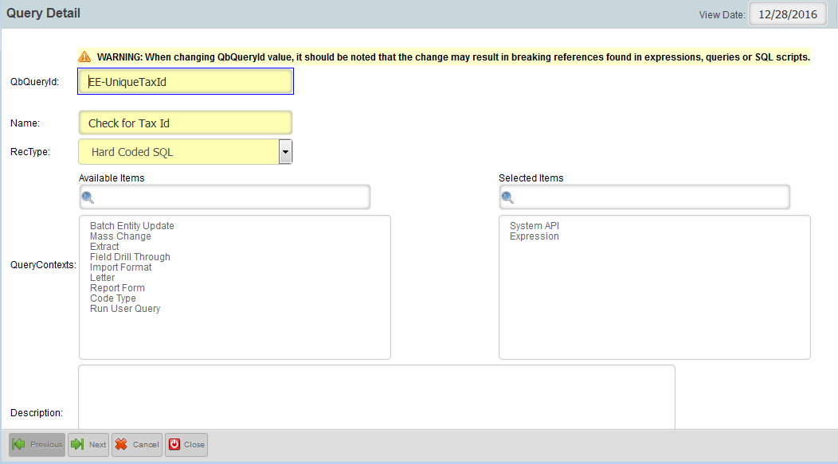
Lesson 2: Reporting QbQuery
QbQuery in Details … need to call SQL and PL/SQL codes.
  Select the RecType as per need viz. Detail, Summary, HardCoded SQL, Stored Procedure.
  Click On “Next”
QbQueryId
Description of the Id
Choose from the drop-down
Next
Notes:
Screen shows step to create QBQuery

Slide 17
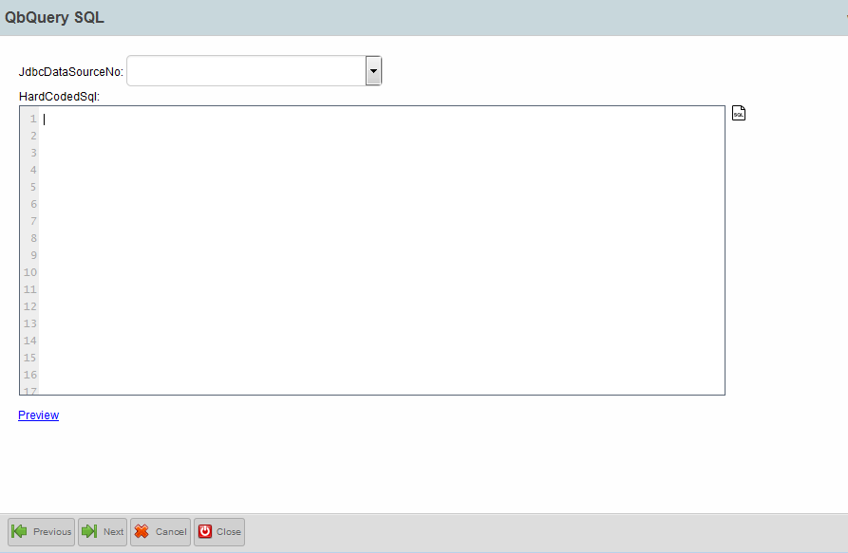
Lesson 2: Reporting Qb Query…Contd
Write the SQL in the hardcoded sql box.
Click on Next and Complete.
Need to write the SQL statement, if it’s a Hard-coded SQL rectype chosen.
Notes:
Here add the SQL or PL/SQL block per requirement.

Slide 18
Test Your Understanding
  How many types of Customer are there?
Notes:
How many types of Customer are there?
Why do we need to select a Primary Agent?
How can we understand “Mandatory” fields in each workspace.
How are tables related to each other?
Why do we write a QBQuery.
Various Rectypes defined in QbQuery.

Slide 19
Test Your Understanding
  Name the various Rectypes defined in QbQuery.
Notes:
How many types of Customer are there?
Why do we need to select a Primary Agent?
How can we understand “Mandatory” fields in each workspace.
How are tables related to each other?
Why do we write a QBQuery.
Various Rectypes defined in QbQuery.

Slide 20

Summary
  You should now be able to:
  Customer Policy, Ownership creation.
  QbQuery utility and creation.
Notes:
You should now be able to describe Customer Policy, Ownership creation and work on QbQuery utility and creation.

